Slide 1


Asansol Engineering College
A Project Presentation on
MediBot
Medicine Recommendation System and Brain Tumor Detection

Slide 2

Team Members:
Pranay Gupta (10800220003)
Nidhi Kumari (10800220071)
Koushik Sadhu (10800220027)
Shuvam Kumar Choudhury (10800220031)

Slide 3
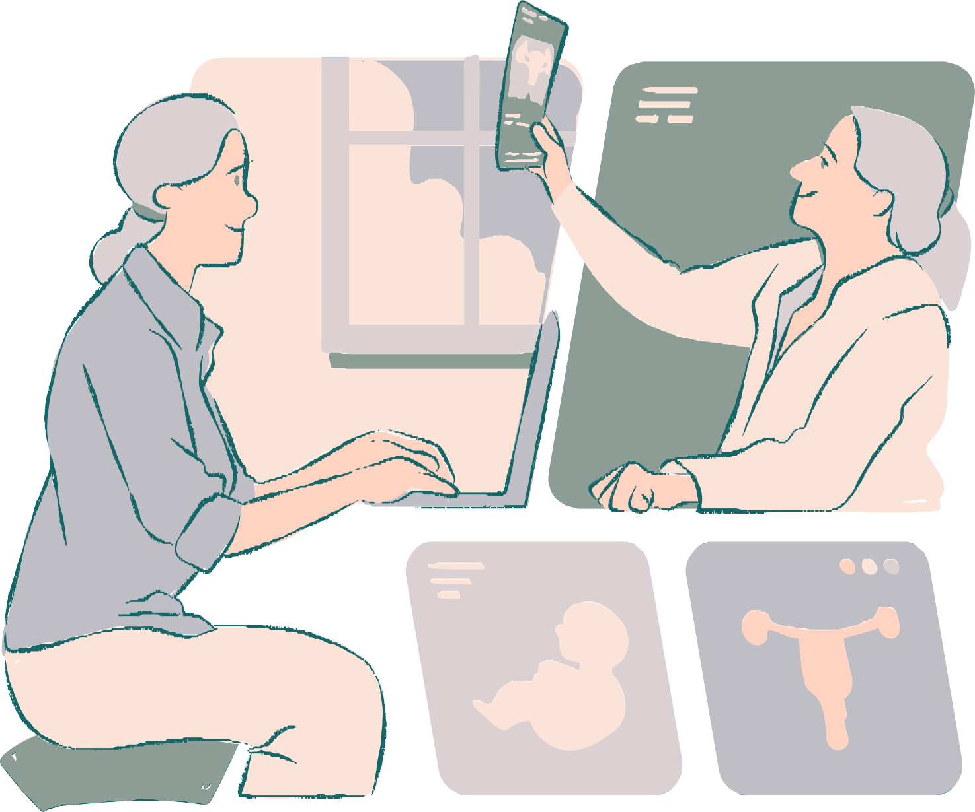
Introduction to MediBot
MediBot addresses the critical issue of medicine recommendation and timely brain tumor detection through an AI-driven web interface. The project aims to provide efficient and accessible solutions to pressing healthcare challenges.

Slide 4

OurApproach
MediBot uses AI and image processing for personalized medicine recommendations and early brain tumor detection. Our web interface ensures efficient, accessible, and accurate healthcare solutions by analyzing patient data and MRI scans.

Slide 5
Technical Explanation of Medicine Recommendation System
01.
Data Preparation and Vectorization
02.
Model Development and Validation
03.
Medicine Prediction

Slide 6
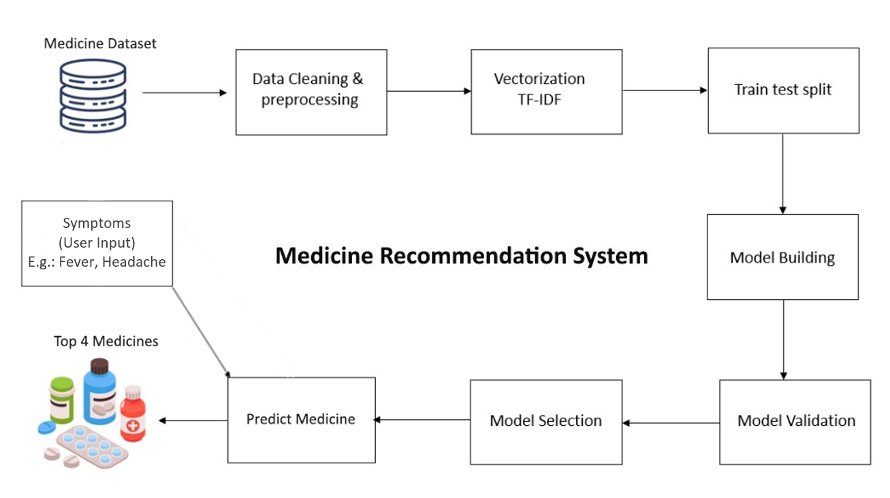
Workflow Diagram of Medicine Recommendation System

Slide 7
Technical Explanation of Brain Tumor Detection
01.
Data Preparation and Preprocessing
02.
Feature Extraction and Model Training
03.
Model Validation and Prediction

Slide 8
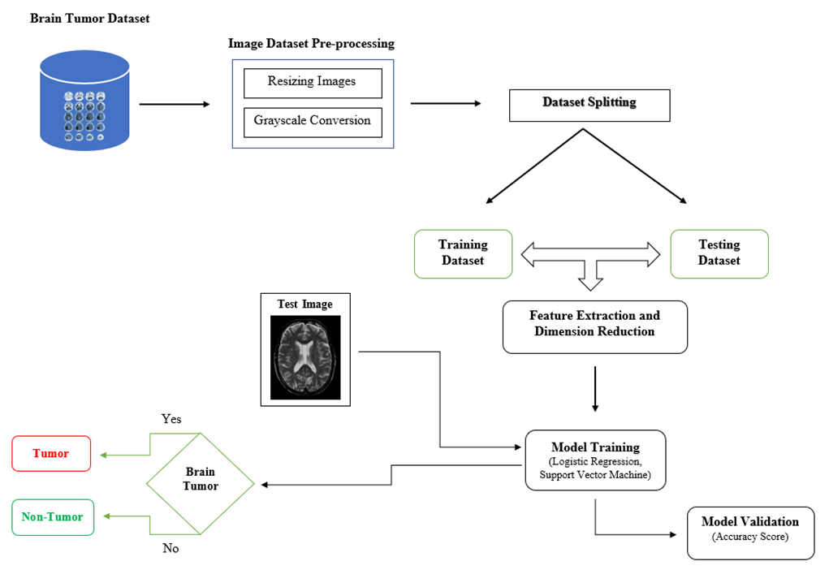
Workflow Diagram of Brain Tumor Detection

Slide 9
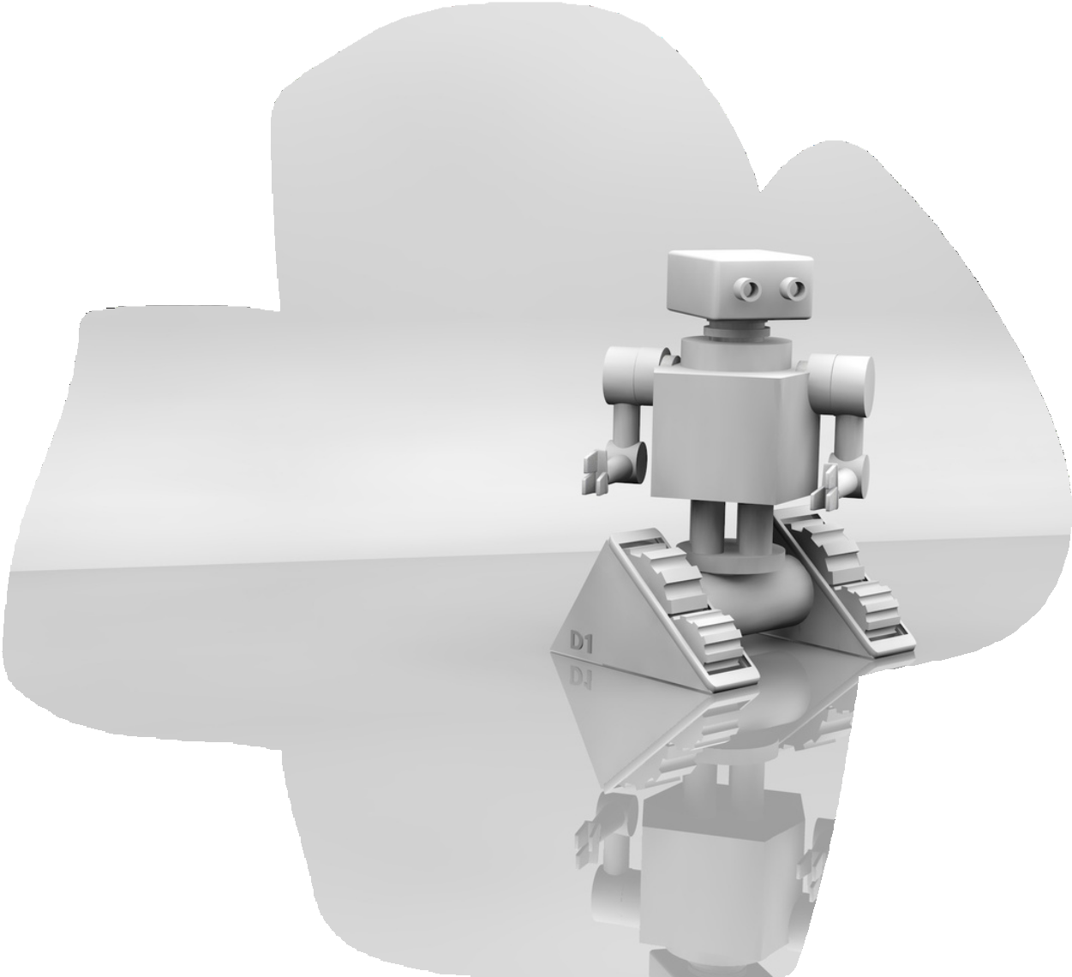
Tech Stack Used
Frontend: React JS, Tailwind CSS
Backend: FastAPI, Python
ML Models: Logistic Regression, Support Vector Machine (SVM), TFIDF Vectorizer, Cosine Similarity

Slide 10
Personalized Medicine Recommendations
01.
Outcomes
_{02.} Accurate Brain Tumor Detection
The outcomes of the MediBot Medicine Recommendation System and Brain Tumor Detection project are multifaceted, encompassing advancements in healthcare, technology, and patient care.
_{03.} Increased Efficiency in Healthcare
_{04.} Accessible Diagnostic Tools through a web interface
_{05.} Potential for Increased Treatment Success

Slide 11
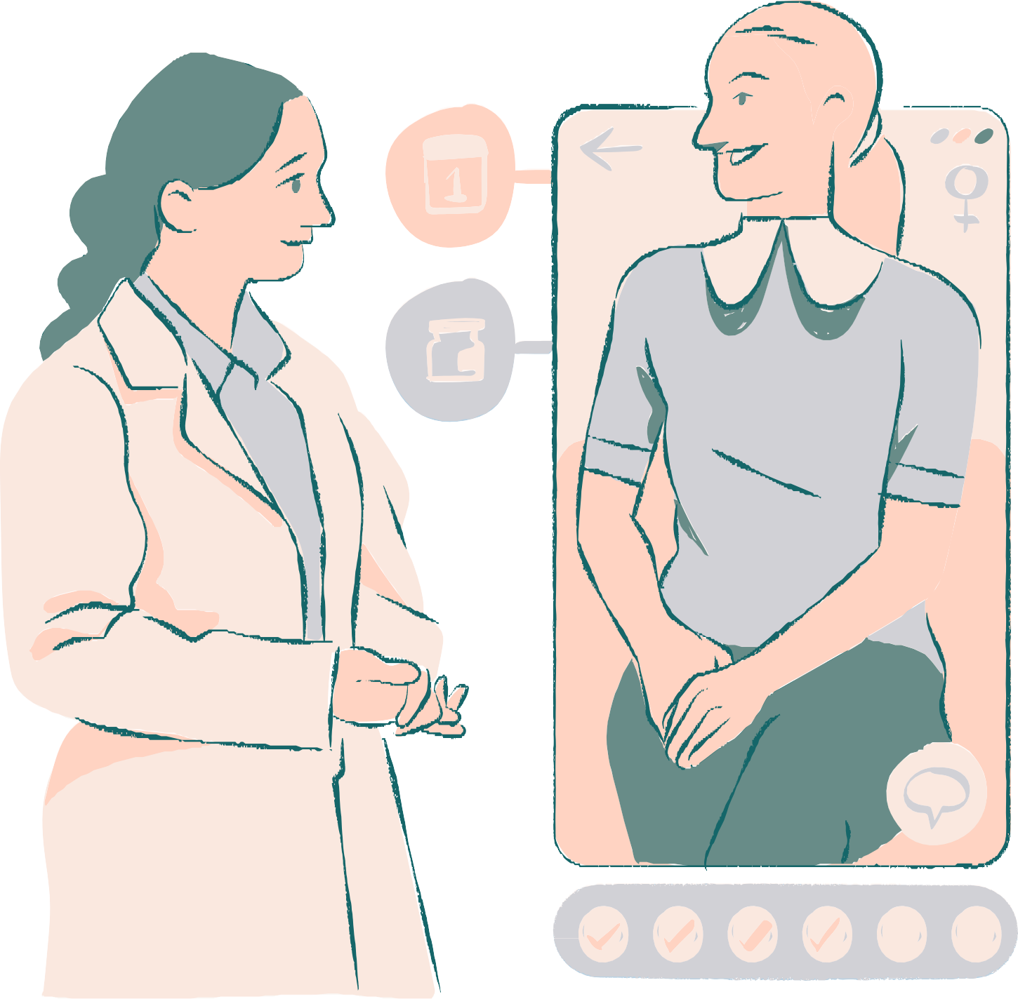
Thank you!

